Slide 1
Chapter 8 Objects and Classes
Part 1

Slide 2
OO Programming Concepts
Object-oriented programming (OOP) involves programming using objects. An object represents an entity in the real world that can be distinctly identified. For example, a student, a desk, a circle, a button, and even a loan can all be viewed as objects. An object has a unique identity, state, and behaviors. The state of an object consists of a set of data fields (also known as properties) with their current values. The behavior of an object is defined by a set of methods.

Slide 3

Objects
An object has both a state and behavior. The state defines the object, and the behavior defines what the object does.

Slide 4
Classes
Classes are constructs that define objects of the same type. A Java class uses variables to define data fields and methods to define behaviors. Additionally, a class provides a special type of methods, known as constructors, which are invoked to construct objects from the class.

Slide 5
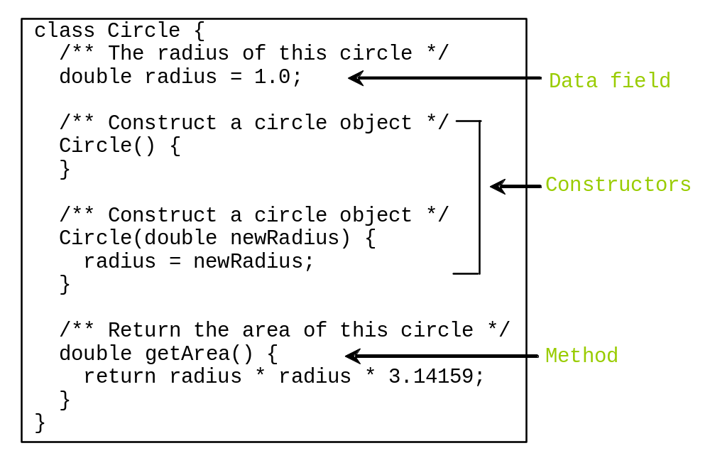
Classes

Slide 6
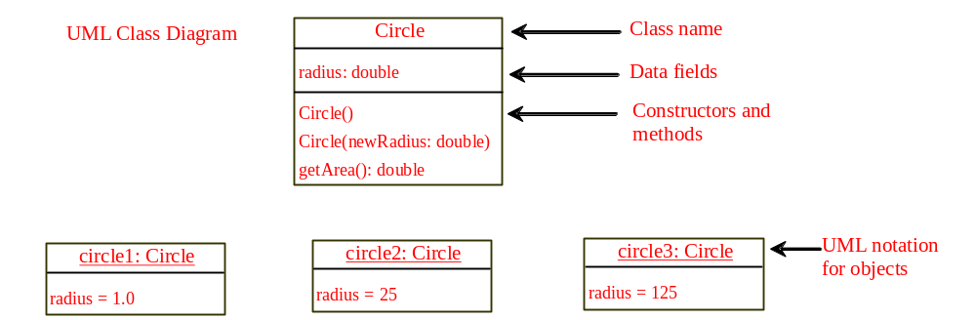
UML Class Diagram

Slide 7
Example: Defining Classes and Creating Objects
Objective: Demonstrate creating objects, accessing data, and using methods.
TestCircle1
Run

Slide 8
Example: Defining Classes and Creating Objects
Objective: Demonstrate creating objects, accessing data, and using methods.
TV
TestTV
Run

Slide 9
Constructors
Constructors are a special kind of methods that are invoked to construct objects.
Circle() {
}
Circle(double newRadius) {
radius = newRadius;
}

Slide 10
Constructors, cont.
A constructor with no parameters is referred to as a no-arg constructor.
Constructors must have the same name as the class itself.
Constructors do not have a return type—not even void.
Constructors are invoked using the new operator when an object is created. Constructors play the role of initializing objects.

Slide 11
Creating Objects Using Constructors
new ClassName();
Example:
new Circle();
new Circle(5.0);

Slide 12
Default Constructor
A class may be declared without constructors. In this case, a no-arg constructor with an empty body is implicitly declared in the class. This constructor, called a default constructor, is provided automatically only if no constructors are explicitly declared in the class.

Slide 13
Declaring/Creating Objects in a Single Step
ClassName objectRefVar = new ClassName();
Example:
Circle myCircle = new Circle();
Assign object reference
Create an object

Slide 14
Accessing Objects
Referencing the object’s data:
objectRefVar.data
e.g., myCircle.radius
Invoking the object’s method:
objectRefVar.methodName(arguments)
e.g., myCircle.getArea()

Slide 15
Trace Code
animation
Declare myCircle
Circle myCircle = new Circle(5.0);
SCircle yourCircle = new Circle();
yourCircle.radius = 100;
myCircle
no value

Slide 16

Trace Code, cont.
animation
Circle myCircle = new Circle(5.0);
Circle yourCircle = new Circle();
yourCircle.radius = 100;
myCircle
no value
Create a circle

Slide 17
Trace Code, cont.
animation
Circle myCircle = new Circle(5.0);
Circle yourCircle = new Circle();
yourCircle.radius = 100;
myCircle
reference value
Assign object reference to myCircle

Slide 18
Trace Code, cont.
animation
Circle myCircle = new Circle(5.0);
Circle yourCircle = new Circle();
yourCircle.radius = 100;
myCircle
reference value
yourCircle
no value
Declare yourCircle

Slide 19

Trace Code, cont.
animation
Circle myCircle = new Circle(5.0);
Circle yourCircle = new Circle();
yourCircle.radius = 100;
myCircle
reference value
yourCircle
no value
Create a new Circle object

Slide 20

Trace Code, cont.
animation
Circle myCircle = new Circle(5.0);
Circle yourCircle = new Circle();
yourCircle.radius = 100;
myCircle
reference value
yourCircle
reference value
Assign object reference to yourCircle

Slide 21

Trace Code, cont.
animation
Circle myCircle = new Circle(5.0);
Circle yourCircle = new Circle();
yourCircle.radius = 100;
myCircle
reference value
yourCircle
reference value
Change radius in yourCircle

Slide 22
Reference Data Fields
The data fields can be of reference types. For example, the following Student class contains a data field name of the String type.
public class Student {
String name; // name has default value null
int age; // age has default value 0
boolean isScienceMajor; // isScienceMajor has default value false
char gender; // c has default value '\u0000'
}

Slide 23
The null Value
If a data field of a reference type does not reference any object, the data field holds a special literal value, null.

Slide 24
Default Value for a Data Field
The default value of a data field is null for a reference type, 0 for a numeric type, false for a boolean type, and '\u0000' for a char type. However, Java assigns no default value to a local variable inside a method.
public class Test {
public static void main(String[] args) {
Student student = new Student();
System.out.println("name? " + student.name);
System.out.println("age? " + student.age);
System.out.println("isScienceMajor? " + student.isScienceMajor);
System.out.println("gender? " + student.gender);
}
}

Slide 25
Example
Java assigns no default value to a local variable inside a method.
public class Test {
public static void main(String[] args) {
int x; // x has no default value
String y; // y has no default value
System.out.println("x is " + x);
System.out.println("y is " + y);
}
}
Compilation error: variables not initialized

Slide 26

The Date Class
Java provides a system-independent encapsulation of date and time in the java.util.Date class. You can use the Date class to create an instance for the current date and time and use its toString method to return the date and time as a string.

Slide 27
The Date Class Example
For example, the following code
  java.util.Date date = new java.util.Date();
  System.out.println(date.toString());
displays a string like Sun Mar 09 13:50:19 EST 2003.

Slide 28

The Random Class
You have used Math.random() to obtain a random double value between 0.0 and 1.0 (excluding 1.0). A more useful random number generator is provided in the java.util.Random class.

Slide 29
The Random Class Example
If two Random objects have the same seed, they will generate identical sequences of numbers. For example, the following code creates two Random objects with the same seed 3.
Random random1 = new Random(3);
System.out.print("From random1: ");
for (int i = 0; i < 10; i++)
System.out.print(random1.nextInt(1000) + " ");
Random random2 = new Random(3);
System.out.print("\nFrom random2: ");
for (int i = 0; i < 10; i++)
System.out.print(random2.nextInt(1000) + " ");
From random1: 734 660 210 581 128 202 549 564 459 961
From random2: 734 660 210 581 128 202 549 564 459 961

Slide 30
Displaying GUI Components
When you develop programs to create graphical user interfaces, you will use Java classes such as JFrame, JButton, JRadioButton, JComboBox, and JList to create frames, buttons, radio buttons, combo boxes, lists, and so on. Here is an example that creates two windows using the JFrame class.
TestFrame
Run

Slide 31
Trace Code
animation
Declare, create, and assign in one statement
JFrame frame1 = new JFrame(); frame1.setTitle("Window 1"); frame1.setSize(200, 150); frame1.setVisible(true); JFrame frame2 = new JFrame(); frame2.setTitle("Window 2"); frame2.setSize(200, 150); frame2.setVisible(true);
frame1
reference
  : JFrame
title:
width:
height:
visible:

Slide 32
Trace Code
animation
JFrame frame1 = new JFrame(); frame1.setTitle("Window 1"); frame1.setSize(200, 150); frame1.setVisible(true); JFrame frame2 = new JFrame(); frame2.setTitle("Window 2"); frame2.setSize(200, 150); frame2.setVisible(true);
frame1
reference
Set title property
  : JFrame
title: "Window 1"
width:
height:
visible:

Slide 33
Trace Code
animation
JFrame frame1 = new JFrame(); frame1.setTitle("Window 1"); frame1.setSize(200, 150); frame1.setVisible(true);
JFrame frame2 = new JFrame(); frame2.setTitle("Window 2"); frame2.setSize(200, 150); frame2.setVisible(true);
frame1
reference
  : JFrame
title: "Window 1"
width: 200
height: 150
visible:
Set size property

Slide 34
Trace Code
animation
JFrame frame1 = new JFrame(); frame1.setTitle("Window 1"); frame1.setSize(200, 150); frame1.setVisible(true);
JFrame frame2 = new JFrame(); frame2.setTitle("Window 2"); frame2.setSize(200, 150); frame2.setVisible(true);
frame1
reference
  : JFrame
title: "Window 1"
width: 200
height: 150
visible: true
Set visible property

Slide 35
Trace Code
animation
JFrame frame1 = new JFrame(); frame1.setTitle("Window 1"); frame1.setSize(200, 150); frame1.setVisible(true);
JFrame frame2 = new JFrame(); frame2.setTitle("Window 2"); frame2.setSize(200, 150); frame2.setVisible(true);
frame1
reference
  : JFrame
title: "Window 1"
width: 200
height: 150
visible: true
Declare, create, and assign in one statement
frame2
reference
  : JFrame
title:
width:
height:
visible:

Slide 36
Trace Code
animation
JFrame frame1 = new JFrame(); frame1.setTitle("Window 1"); frame1.setSize(200, 150); frame1.setVisible(true);
JFrame frame2 = new JFrame(); frame2.setTitle("Window 2"); frame2.setSize(200, 150); frame2.setVisible(true);
frame1
reference
  : JFrame
title: "Window 1"
width: 200
height: 150
visible: true
frame2
reference
Set title property
  : JFrame
title: "Window 2"
width:
height:
visible:

Slide 37
Trace Code
animation
JFrame frame1 = new JFrame(); frame1.setTitle("Window 1"); frame1.setSize(200, 150); frame1.setVisible(true);
JFrame frame2 = new JFrame(); frame2.setTitle("Window 2"); frame2.setSize(200, 150); frame2.setVisible(true);
frame1
reference
  : JFrame
title: "Window 1"
width: 200
height: 150
visible: true
frame2
reference
  : JFrame
title: "Window 2"
width: 200
height: 150
visible:
Set size property

Slide 38
Trace Code
animation
JFrame frame1 = new JFrame(); frame1.setTitle("Window 1"); frame1.setSize(200, 150); frame1.setVisible(true);
JFrame frame2 = new JFrame(); frame2.setTitle("Window 2"); frame2.setSize(200, 150); frame2.setVisible(true);
frame1
reference
  : JFrame
title: "Window 1"
width: 200
height: 150
visible: true
frame2
reference
  : JFrame
title: "Window 2"
width: 200
height: 150
visible: true
Set visible property

